Slide 1
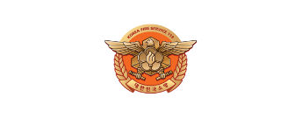
[Episode.5 ]
Construction Site
Fire Safety
Disabled
Woman
Elderly
Foreigner

Slide 2
Contents
[Episode.5]
Construction Site Fire Safety
1. Why Construction Sites Are Vulnerable_ 2p
2. Safety Precautions When Welding_ 6p
3. How To Use A Fire Extinguisher_ 8p
Disabled
Woman
Elderly
Foreigner

Slide 3
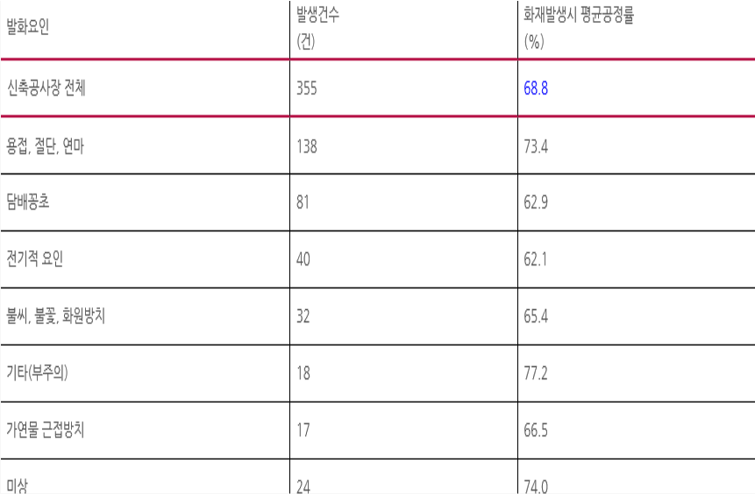
1
Why Construction Sites Are Vulnerable
Causes of fire at construction sites (Seoul, ‘14~’17)
number of occurrences
Ignition Factors
Ignition Factors
(Number)
All new construction sites
Welding, Cutting, Polishing
Cigarette
Electrical factors
Fire Embers, Sparks, and Fire Source Neglect
Other (inattention)
Flammable Objects
Unknown
Disabled
Woman
Elderly
Foreigner

Slide 4
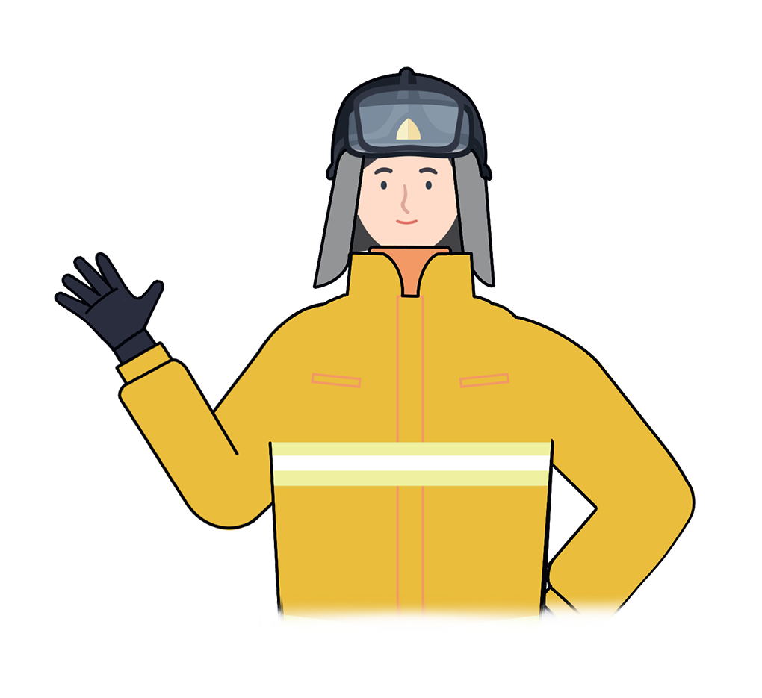
1
Why Construction Sites Are Vulnerable
“
Fire and explosion accidents at construction sites are constantly happening
Especially for foreign workers who are not fluent in local language, they are exposed with higher risk when a fire occurs
40% of fires occur when workers perform welding, grinding or cutting tasks
“
Disabled
Woman
Elderly
Foreigner

Slide 5
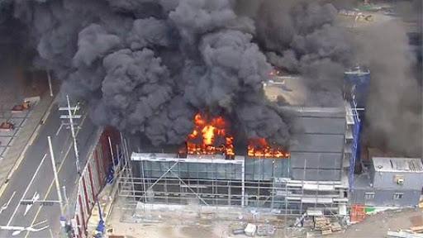
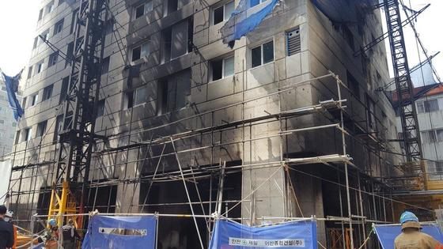
1
Why Construction Sites Are Vulnerable
On March 27, 2019 at a construction site of a shopping mall in Yong In, a fire caused by welding operation injured 13 people.
Fires from welding cause great damage to people and property
In March 2018, at the construction
site of a shopping complex in
Bupyong, a welding operation
caused 2 deaths and 5 injuries.
Disabled
Woman
Elderly
Foreigner

Slide 6
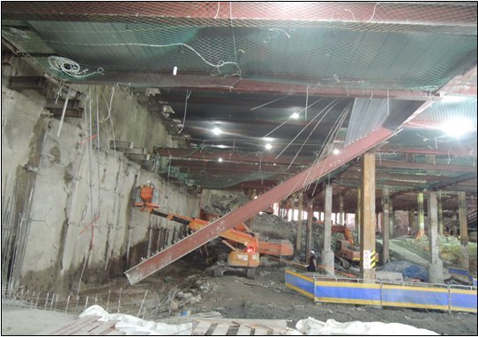
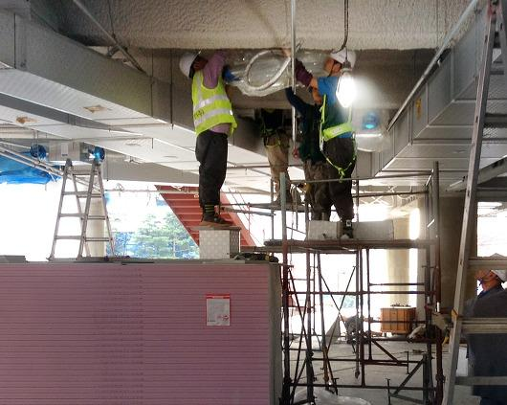
1
Why Construction Sites Are Vulnerable
Because there are always inflammable and explosive materials on construction sites
Efforts should be made to prevent fire and explosion such as using non-flammable materials for the construction site or continuously spraying water around the construction site.
Disabled
Woman
Elderly
Foreigner

Slide 7
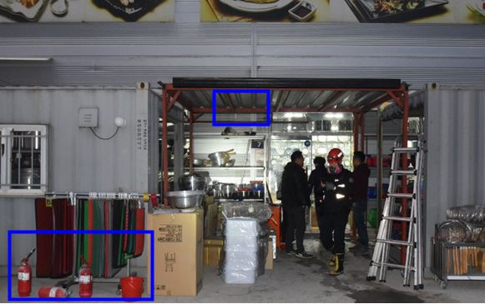
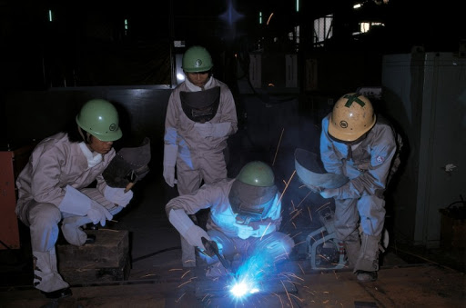
Safety Precautions When Welding
2
Prepare fire fighting equipment within 5 meters from the welding spot
Do not keep flammable materials within 10 meters from the welding spot
Disabled
Woman
Elderly
Foreigner

Slide 8
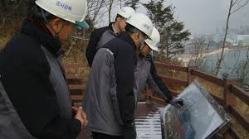
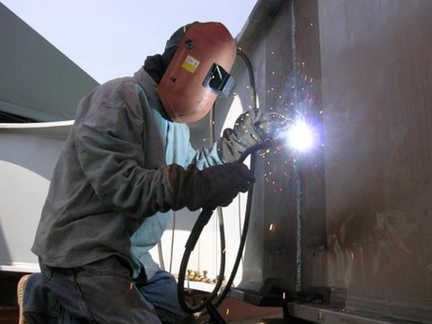
Safety Precautions When Welding
2
Wear personal protective equipment on the job
Check the construction area every 30 minutes when perform welding operations
Disabled
Woman
Elderly
Foreigner

Slide 9
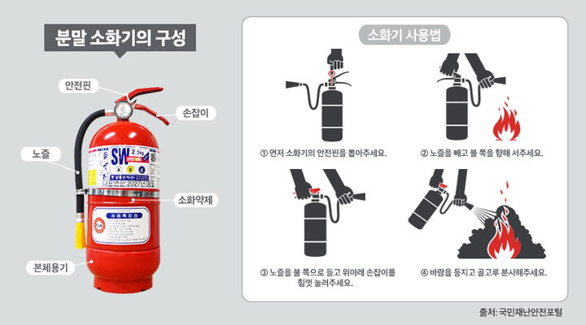
3
How To Use A Fire Extinguisher
Composition of the
powder fire extinguisher
1. Bring a fire extinguisher to a fire area
2. Remove the safety latch
3. Pull the wire and direct it toward the fire
4. Grasp the handle tightly
5. Spray evenly into the fire
How to use a fire extinguisher
Safety Pin
Handle
Nozzle
How to use a fire extinguisher
Remove the nozzle and
stand towards the fire
fire
Extinguishing
agent
Nozzle
Hold the nozzle toward the
fire and press the handle
up and down with force
Spray the wind evenly
Disabled
Woman
Elderly
Foreigner

Slide 10
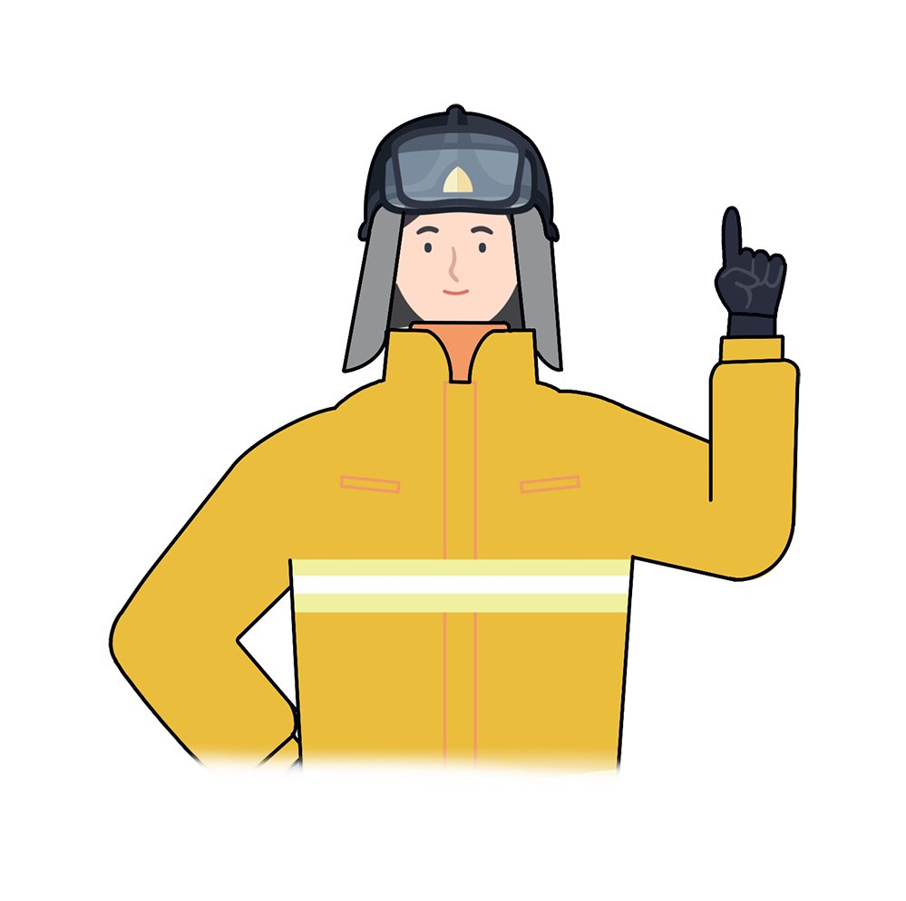
*
Key Points for Fire Safety
“
Pay special attention
when carrying out welding, grinding and cutting operations in a construction site vulnerable to fire.
Strictly comply with safety regulations at the construction sites to ensure the lives of yourself and those around you
“
Disabled
Woman
Elderly
Foreigner

Slide 11
Construction Site Fire Safety
Fire safety training is the foundation for a safe society and happy people

